Slide 1

M5 – Visual Recognition
Project: Cross-modal Retrieval
Final Presentation
​
Group 3: Guillem Capellera, Abel García, Johnny Nuñez and Anna Oliveras
Notes:
My name is
What?
My name is
Who?
My name is
Chika-chika
Slim Shady

Slide 2

Outline
Internal Organization
Project Summary & Previous weeks review
Cross-Modal Retrieval (Week 5)
3.1 Image-to-Text
3.2 Text-to-Image
Conclusions
Notes:
Task a:
Object detection models such as FasterRCNN and MaskRCNN can struggle with object recognition when textures are similar or when objects are outside their context. FasterRCNN can misclassify objects with similar textures, while MaskRCNN can more accurately detect such objects. However, both models can still correctly detect and label objects outside their context in most cases.
Task b:
When transplanting objects into new images using MaskRCNN, the model is generally able to recognize the transplanted objects, especially for cases such as dogs and clocks. However, in some cases, such as TVs in dark backgrounds, the model may fail to detect the objects. This highlights the importance of background and lighting conditions for object detection.
Task c:
The background of an image plays a critical role in object detection accuracy, and overlapping or partially occluded objects can be challenging for the model. Duplicating objects in an image can provide additional information that can help the model detect and classify objects more accurately, especially if the duplicated object is in a different location or under different lighting conditions than the original object.
Task d:
Feature interference can be harmful to the detection process in MaskRCNN, as features obtained from pixels outside the region of interest can interfere with the predictions. Adding random noise can further amplify this issue. Therefore, it is essential to pay attention to the pixels and features included in the model's training and detection processes.
Task e:
Style transfer can impact object detectability, as some styles may result in texture loss and non-uniform contours, making it more difficult for object detection models to identify objects. It is important to choose styles that preserve object details and contours to minimize the impact on object detection accuracy.

Slide 3
1. Internal organization

Slide 4

Internal organization
Communication: Whatsapp Group / Discord
Each week we analyzed the payload and the complexity of each
task and divided them so that each team member had to do
approximately the same amount of work.
In the weekend, do the presentation slides and the overleaf report together.
When problems encountered in each of the individual tasks, report it to the group and help each other to pull the task forward.
Notes:
Task a:
Object detection models such as FasterRCNN and MaskRCNN can struggle with object recognition when textures are similar or when objects are outside their context. FasterRCNN can misclassify objects with similar textures, while MaskRCNN can more accurately detect such objects. However, both models can still correctly detect and label objects outside their context in most cases.
Task b:
When transplanting objects into new images using MaskRCNN, the model is generally able to recognize the transplanted objects, especially for cases such as dogs and clocks. However, in some cases, such as TVs in dark backgrounds, the model may fail to detect the objects. This highlights the importance of background and lighting conditions for object detection.
Task c:
The background of an image plays a critical role in object detection accuracy, and overlapping or partially occluded objects can be challenging for the model. Duplicating objects in an image can provide additional information that can help the model detect and classify objects more accurately, especially if the duplicated object is in a different location or under different lighting conditions than the original object.
Task d:
Feature interference can be harmful to the detection process in MaskRCNN, as features obtained from pixels outside the region of interest can interfere with the predictions. Adding random noise can further amplify this issue. Therefore, it is essential to pay attention to the pixels and features included in the model's training and detection processes.
Task e:
Style transfer can impact object detectability, as some styles may result in texture loss and non-uniform contours, making it more difficult for object detection models to identify objects. It is important to choose styles that preserve object details and contours to minimize the impact on object detection accuracy.

Slide 5
2. Project summary & Previous weeks review

Slide 6
Project summary
Introduction to Pytorch
Introduction to Object Detection and Segmentation
Challenges of Object Detection and Segmentation
Image Retrieval
Cross-Modal Retrieval
Week 1
Week 2
Week 3
Week 4
Week 5
Week 1
Week 2
Week 3
Week 4
Week 5
MIT-Split Dataset
KITTI-MOTS Dataset
Out-of-Context &
MSCOCO Dataset
MIT-Split Dataset
COCO 2014
COCO 2014

Slide 7
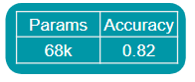
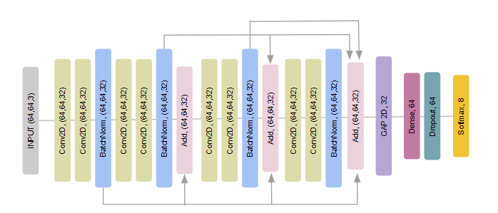


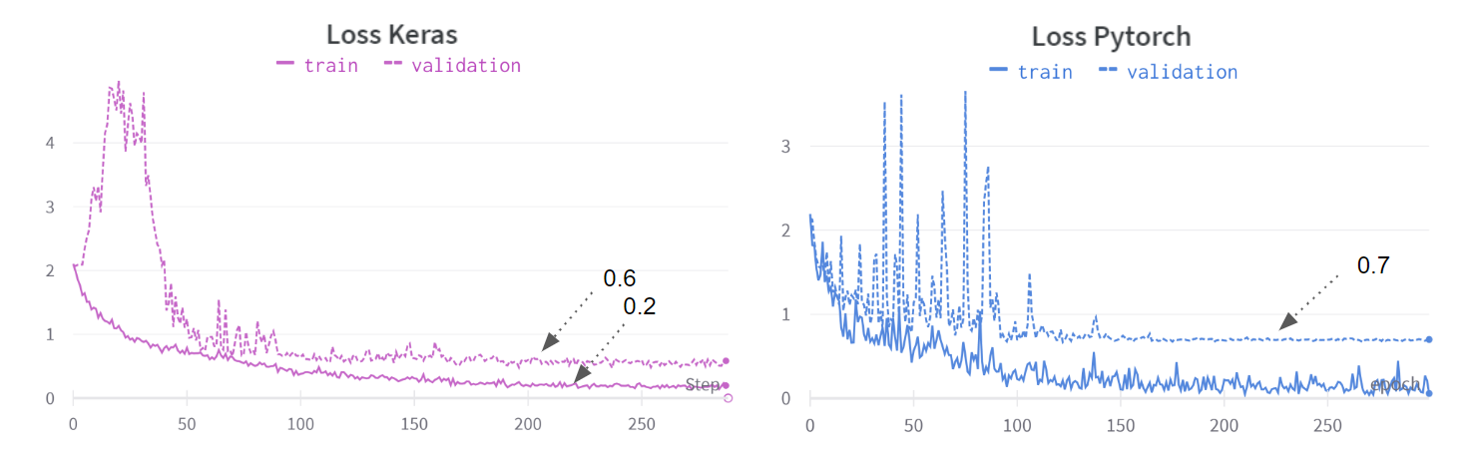
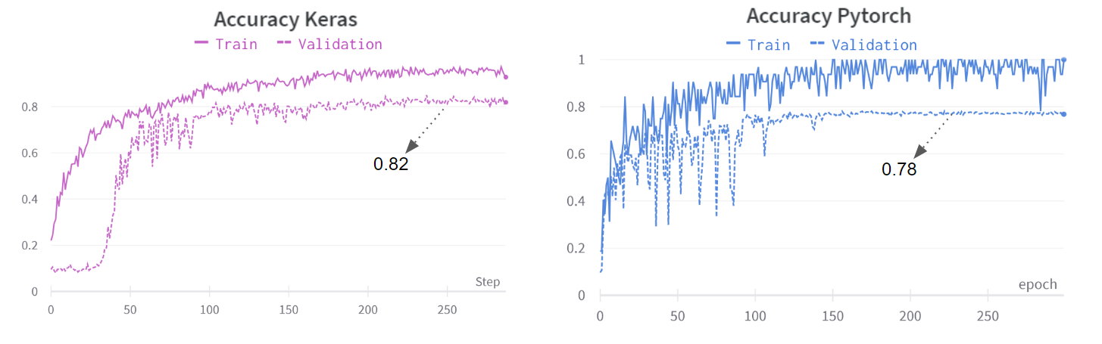
Week 1: Introduction to Pytorch
Goals
Understand Pytorch framework.
Implement Image Classification network from M3 in Pytorch.
Compare the loss and accuracy and compare them with the one from Keras.
vs
Results
Keras has a simple architecture → more readable and easy to use.
PyTorch provides a more low-level approach → more control of the network & training pipeline.
Change in the dimensions with respect to Keras.
Successfully replicate the same network → similar results
Training may be slightly different but in Keras we optimized all the hyperparameters.
Notes:
Keras (high-level neural network API) has a simple architecture → more readable and easy to use.
PyTorch provides a more low-level approach, we have more control of the network, training pipeline.
Change in the dimensions with respect to Keras.
We were able to replicate the same network successfully and similar results were achieved, although in our case Keras worked a bit better.
Training may be slightly different and in Keras we optimized all the hyperparameters.

Slide 8

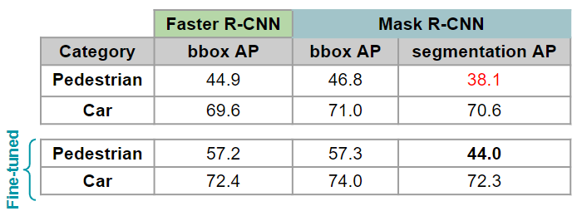
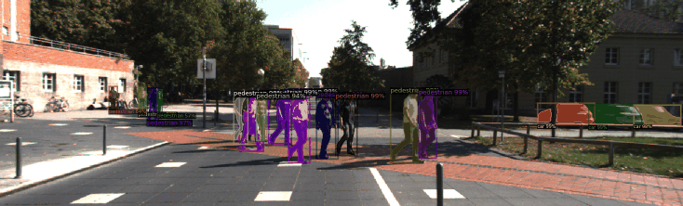
Week 2: Introduction to Object Detection and Segmentation
Goals
Get familiar with Detectron2 [1] framework.
Evaluate inference and fine-tuning on KITTI MOTS dataset with:
Faster R-CNN [3] (detection) → Backbone Faster_rcnn_X_101_32x8d_FPN_3x
Mask R-CNN [4] (detection and segmentation) → Backbone Mask_rcnn_X_101_32x8d_FPN_3x
Results
Detectron 2 → Understanding detectron2 source code creating Pull Request to update the repository to create wheels for new hardware and code.
Mask R-CNN has better Average Precision and Recall than Faster R-CNN → Better in detecting objects in the KITTI-MOTS [2] dataset.
Fine-tuning
→ Improves a lot the performance on pedestrian’s class (+10 p).
→ Improves the overall results.
Notes:
Detectron 2 → Understanding detectron2 source code creating Pull Request to update the repository to create wheels for new hardware and code.
Mask R-CNN has better Average Precision and Recall than Faster R-CNN → Better in detecting objects in the KITTI-MOTS [2] dataset
Fine-tuning
→ Improves a lot the performance on pedestrian’s class (+10 p)
→ Improves the overall results
Understanding Mixed Precision and another techniques for training and inference.

Slide 9
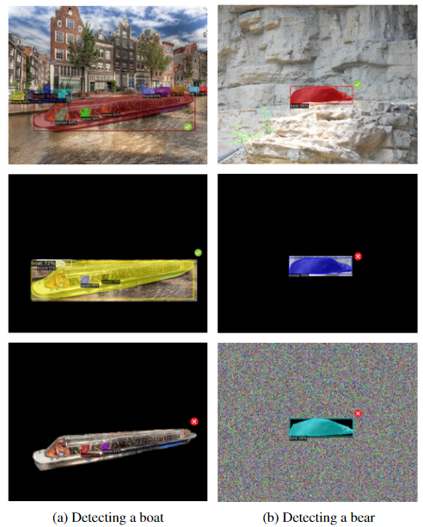
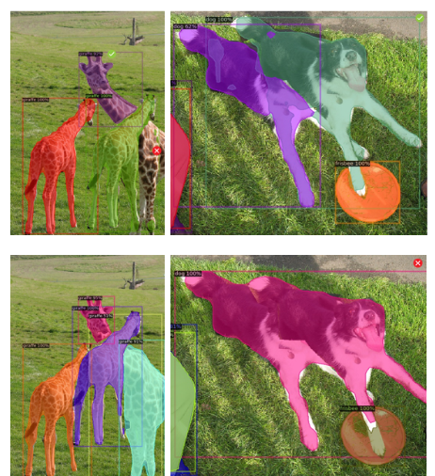
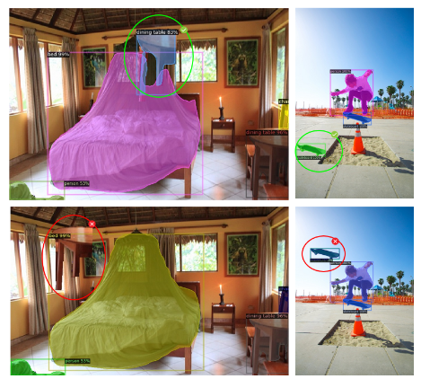
Week 3: Challenges of Object Detection and Segmentation
Goals
Evaluate how context and feature interference affects the object detection and segmentation
→ Out-Of-Context dataset [5]
→ Transplanting objects with MS-COCO [6] dataset
→ Other image modifications to evaluate feature interference like adding random noise
Results
In the majority of the cases, both Mask R-CNN[4] and Faster R-CNN[3] are still able to correctly detect and label objects outside their context.
Object detection with Mask R-CNN is generally more robust than with Faster R-CNN
The amount of overlap is a determinant factor of whether or not the
object instances are differentiated.
Feature interference can be harmful to the detection process in Mask
R-CNN → pixels outside and inside the region of interest.
Notes:
In the majority of the cases, both Mask R-CNN[4] and Faster R-CNN[3] are still able to correctly detect and label objects outside their context.
Object detection with Mask R-CNN is generally more robust than with Faster R-CNN, especially in cases where object textures and colors are similar to the background. In some
examples the background is also crucial to classify well the object.
The amount of overlap is a determinant factor of whether or not the
object instances are differentiated.
Feature interference can be harmful to the detection process in Mask
R-CNN. Features obtained from pixels that do not belong to the actual
object that we want to detect have an effect on the assigned class, even
for pixels outside the region of interest.

Slide 10
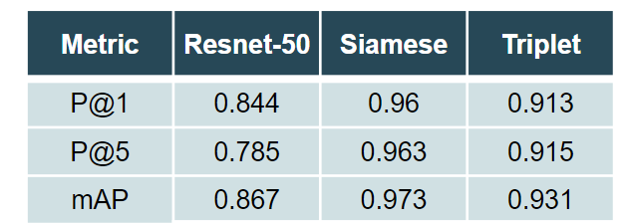
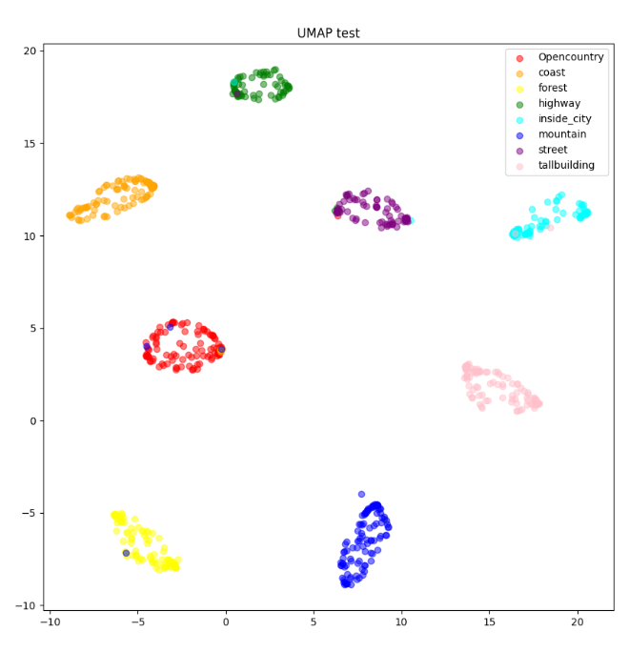
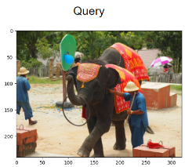
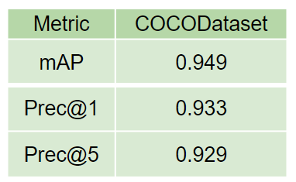
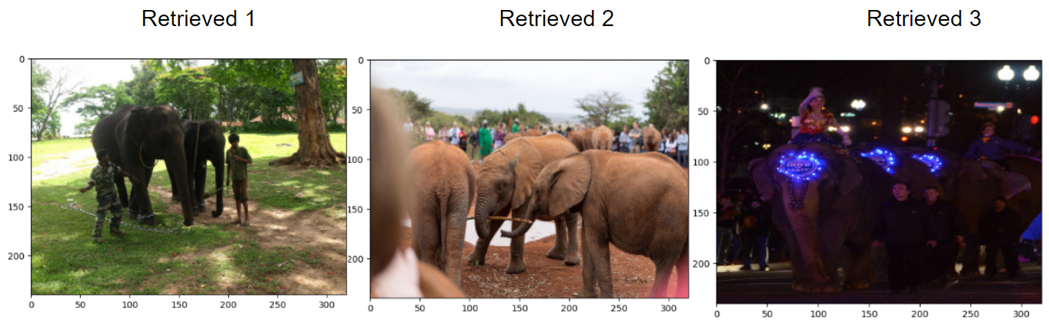
Week 4: Image Retrieval
Goals
Perform image Retrieval on COCO [6] with Faster R-CNN [3] or Mask R-CNN [4]
Train the model on metric learning → Siamese and Triplet Networks
Results
Image retrieval with Resnet-50 [7] resulted in worse results than when using the Siamese or Triplet networks.
Triplet networks are harder to train and in our case it performed slightly worse than Siamese.
TSME and UMAP are powerful tools to understand metric learning and imagine better the distribution of the classes.
Image retrieval with Faster-RCNN with ResNet-50 as the backbone:
→ The method without the FC layer → lower loss values.
→ Visual inspection of the retrieved images shows room for improvement.
→ More rigorous metrics and alternative approaches should be explored
to enhance retrieval performance.
with Siamese network
Notes:
Image retrieval with Resnet-50 [7] resulted in worse results than when using the Siamese or Triplet networks.
Triplet networks are harder to train and in our case it performed slightly worse than Siamese.
TSME and UMAP are powerful tools to understand metric learning and imagine better the distribution of the classes.
Faster-RCNN with ResNet-50 as the backbone is employed for image retrieval on the COCO 2014 [6] dataset by generating embeddings using object detection networks.
→ The method without the FC layer exhibits lower loss values.
→ Visual inspection of the retrieved images shows room for improvement.
→ More rigorous metrics and alternative approaches should be explored
to enhance retrieval performance.

Slide 11
3. Cross-Modal Retrieval

Slide 12





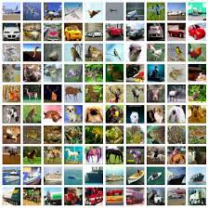
Cross-Modal Retrieval
Goals
Implement basic Image to text retrieval.
Implement basic Text to image retrieval.
Use FastText[8] and BERT[9] embedding as Text feature extractor.
DATASET → COCO 2014 [6]
Images of everyday scenes.
Annotations: object instance masks, object bounding boxes,
and object categories. Each image has 5 captions associated with it.
Train : approximately 82,000 images with over 200,000 labeled objects.
Validation: around 40,000 images with over 100,000 labeled objects.
For the different tasks we use the following random subsets:
Train: All the training images (approximately 82.000)
Validation: last 100 images of the validation set of COCO
Test: 1000 and 100 first images of the validation set of COCO
Notes:
The COCO (Common Objects in Context) dataset is a widely used benchmark for object detection, instance segmentation, and other computer vision tasks. It contains images of everyday scenes that are annotated with object instance masks, object bounding boxes, and object categories.
The training set contains approximately 82,000 images with over 200,000 labeled objects, while the validation set contains around 40,000 images with over 100,000 labeled objects. Each image has 5 captions associated with it.
For the different tasks we use the following random subsets:
→ Train: All the training images (approximately 82.000)
→ Validation: last 100 images of the validation set of COCO
→ Test: 1000 and 100 first images of the validation set of COCO

Slide 13
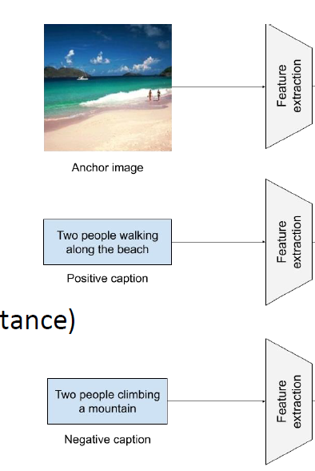
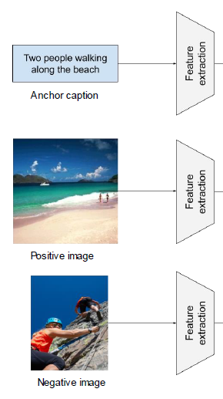
Cross-Modal Retrieval
Image-to-Text Text-to-Image
Retrieval with
KNN
Captions
Retrieval with
KNN
Images
Measure similarity
Metric Learning
Measure similarity
Metric Learning
Measure similarity
Metric Learning
Image stream:
We use the backbone of the networks:
Faster R-CNN [3] pretrained with COCO 2017 dataset [6]
ResNet 50 [6] pretrained with IMAGENET dataset [10]
Language Stream:
FastText [8]
BERT [9]

Slide 14
3. Cross-Modal Retrieval
3.1 Image-to-Text

Slide 15
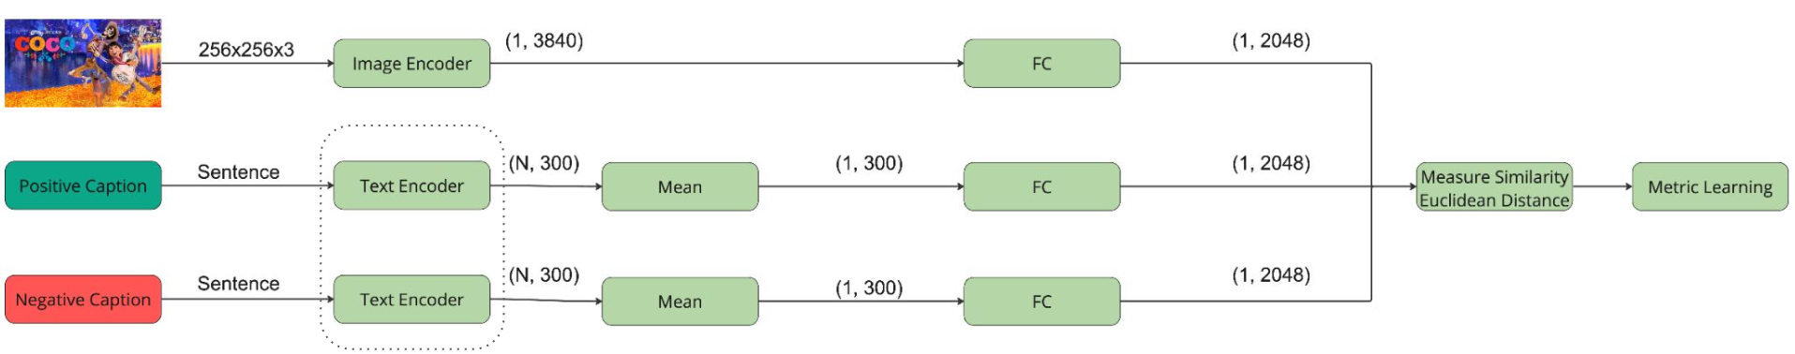

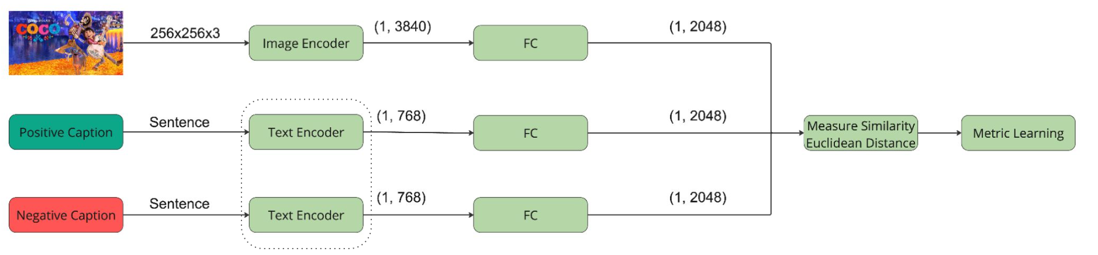

Architectures Image-To-Text
We used the following pipeline with the specified dimensions depending on the text feature extractor.
Anchor
Faster R-CNN
or Resnet 50
*
Retrieval with
KNN
Captions
Triplet loss
Anchor
Faster R-CNN
or Resnet 50
*
Retrieval with
KNN
Captions
*
Depends on the architecture. Visual features were extracted from the last convolutional layer of Faster R-CNN (backbone resnet50, pretrained by COCO dataset).

Slide 16
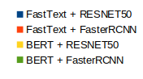
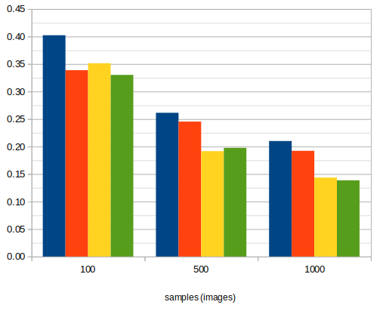
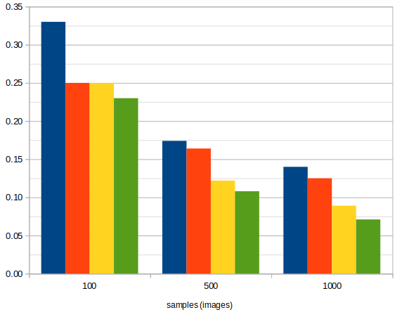
mAP
Quantitative results
Using margin 0.1
Samples | Text Embedding | Image Embedder | mAP | Prec@1 | Prec@3 | Prec@5
100 | FastText | RESNET50 | 0.40 | 0.33 | 0.29 | 0.25
 |  | FasterRCNN | 0.34 | 0.25 | 0.24 | 0.21
 | BERT | RESNET50 | 0.35 | 0.25 | 0.23 | 0.22
 |  | FasterRCNN | 0.33 | 0.23 | 0.21 | 0.21
500 | FastText | RESNET50 | 0.26 | 0.17 | 0.16 | 0.14
 |  | FasterRCNN | 0.25 | 0.16 | 0.14 | 0.13
 | BERT | RESNET50 | 0.19 | 0.12 | 0.10 | 0.10
 |  | FasterRCNN | 0.20 | 0.11 | 0.12 | 0.10
1000 | FastText | RESNET50 | 0.21 | 0.14 | 0.14 | 0.14
 |  | FasterRCNN | 0.19 | 0.13 | 0.10 | 0.13
 | BERT | RESNET50 | 0.14 | 0.09 | 0.07 | 0.10
 |  | FasterRCNN | 0.14 | 0.07 | 0.07 | 0.10
Prec@1

Slide 17
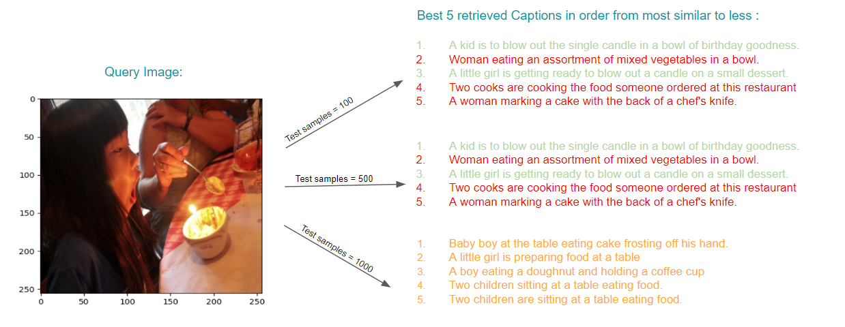
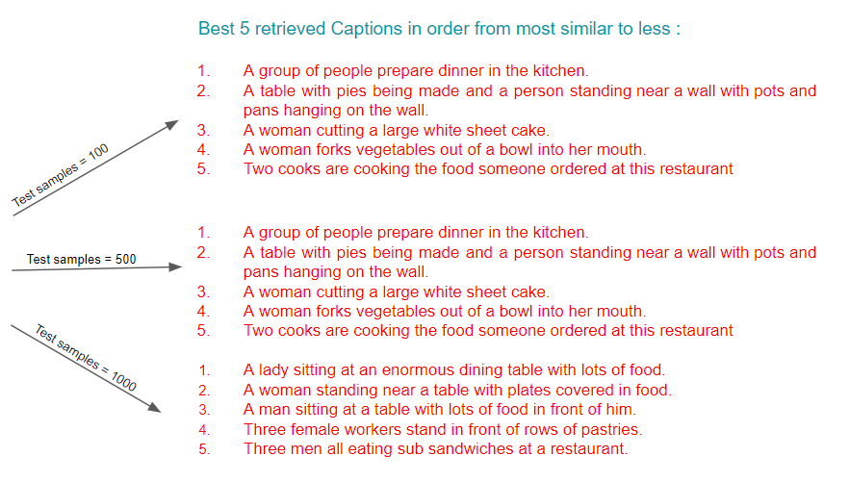
Qualitative results Image-to-Text

Slide 18
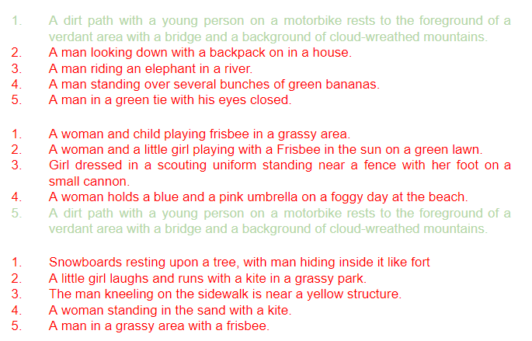
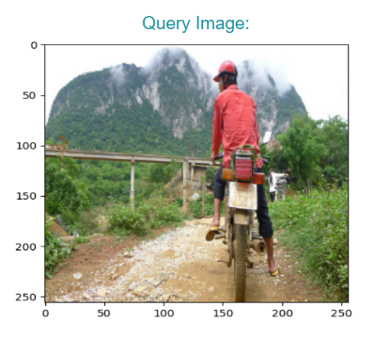
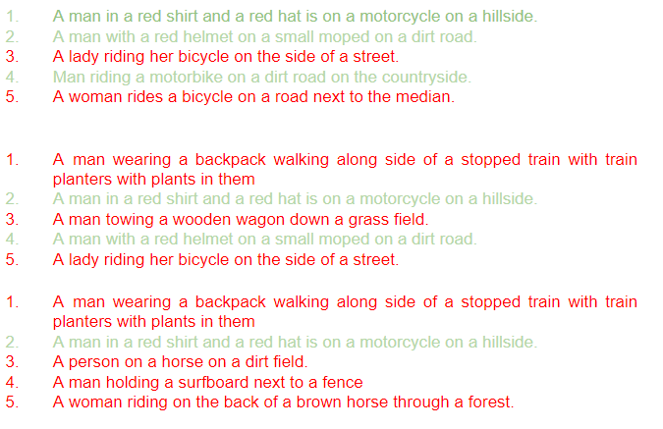
Qualitative results Image-to-Text

Slide 19
3. Cross-Modal Retrieval
3.2 Text-to-Image

Slide 20
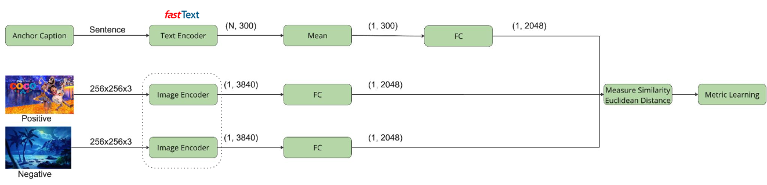
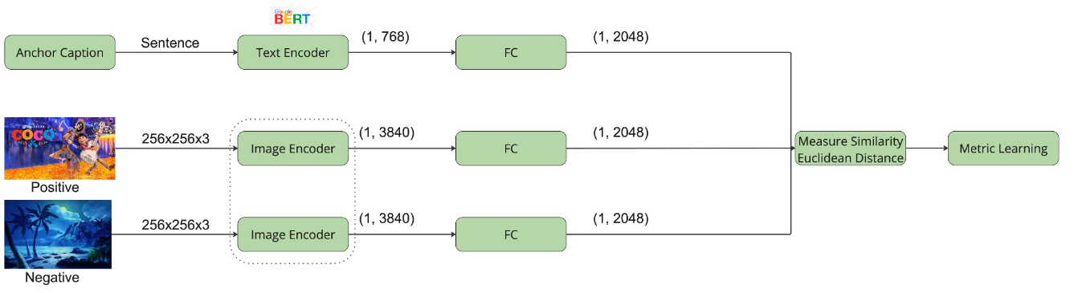
Architecture Text-to-Image
We used the following pipeline with the specified dimensions depending on the text feature extractor.
Retrieval with
KNN
Images
*
Triplet loss
Retrieval with
KNN
Images
*
*
Depends on the architecture. Visual features were extracted from the last convolutional layer of Faster R-CNN (backbone resnet50, pretrained by COCO dataset).

Slide 21
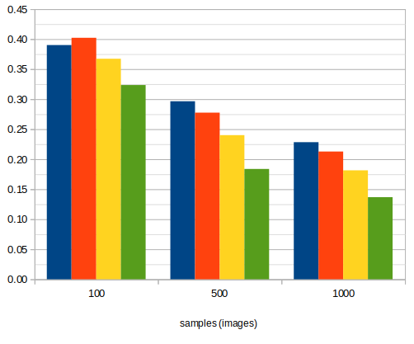
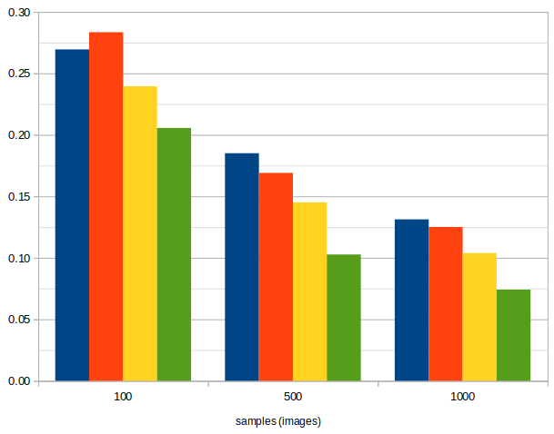
mAP
Quantitative results
Using margin 0.1
Samples | Text Embedding | Image Embedder | mAP | Top-1 | Top-3 | Top-5
100 | FastText | RESNET50 | 0.39 | 0.27 | 0.50 | 0.59
 |  | FasterRCNN | 0.40 | 0.28 | 0.49 | 0.60
 | BERT | RESNET50 | 0.37 | 0.24 | 0.47 | 0.59
 |  | FasterRCNN | 0.32 | 0.21 | 0.31 | 0.42
500 | FastText | RESNET50 | 0.30 | 0.19 | 0.39 | 0.50
 |  | FasterRCNN | 0.28 | 0.17 | 0.36 | 0.47
 | BERT | RESNET50 | 0.24 | 0.15 | 0.31 | 0.42
 |  | FasterRCNN | 0.20 | 0.12 | 0.26 | 0.36
1000 | FastText | RESNET50 | 0.23 | 0.13 | 0.30 | 0.41
 |  | FasterRCNN | 0.21 | 0.13 | 0.27 | 0.38
 | BERT | RESNET50 | 0.18 | 0.10 | 0.24 | 0.34
 |  | FasterRCNN | 0.14 | 0.07 | 0.18 | 0.26
Top-1

Slide 22
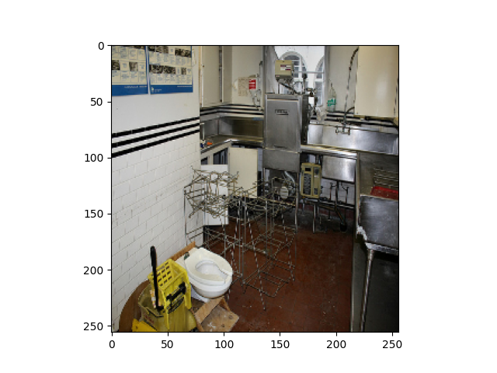
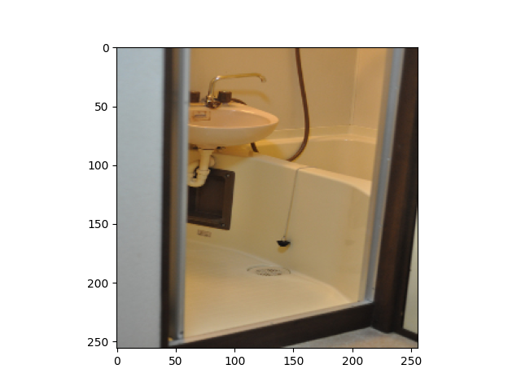
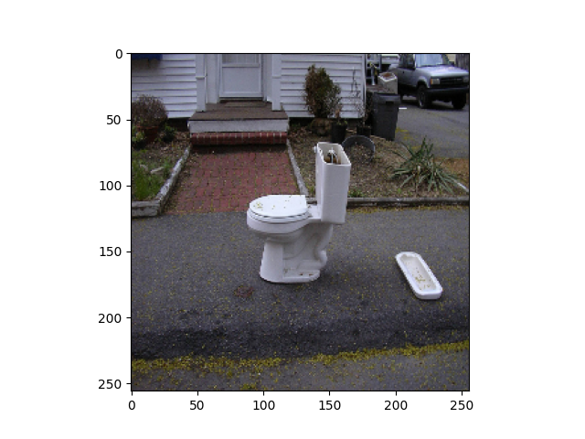
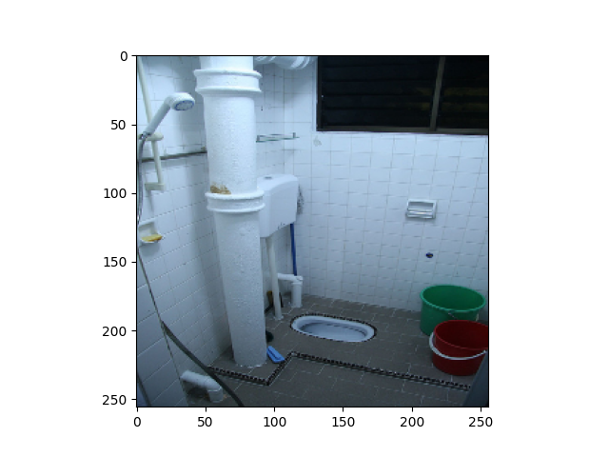
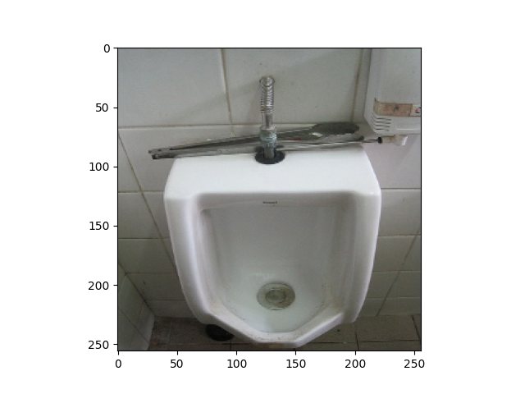
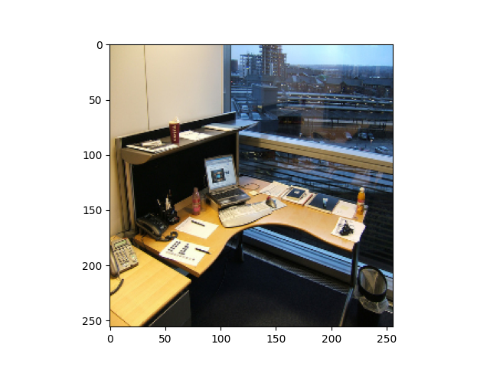
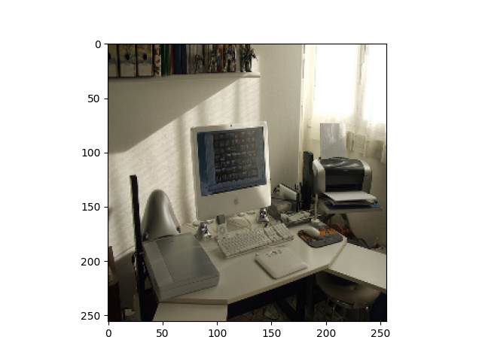
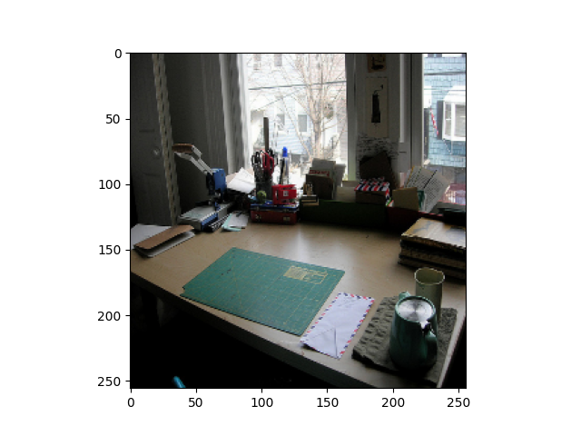
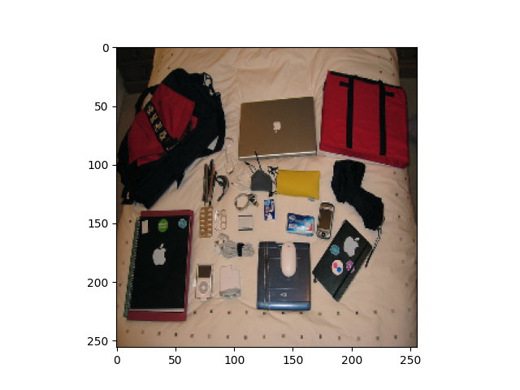
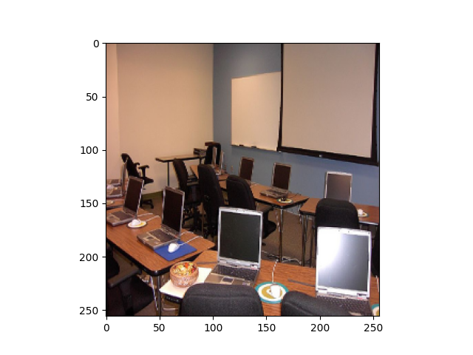
Qualitative results Text-to-Image (using FastText)
GOOD CASE: Query Caption: A small closed toilet in a cramped space.
Best 5 retrieved images in order from most similar to less (from left to right):
BAD CASE: Query Caption: Office space with office equipment on desktop.
Best 5 retrieved images in order from most similar to less (from left to right):

Slide 23
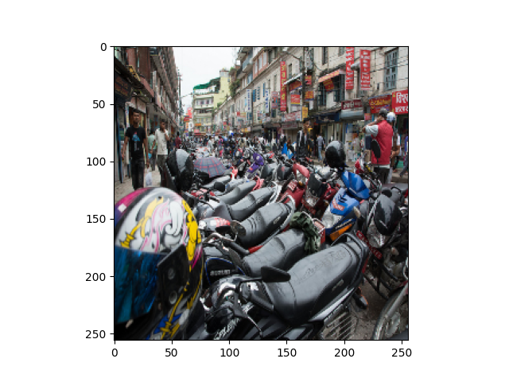
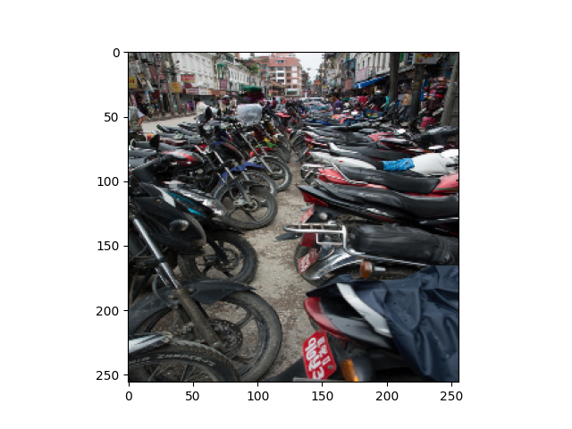
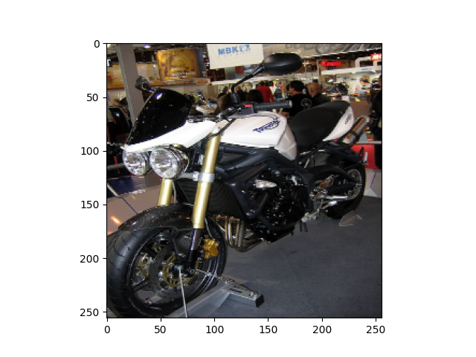
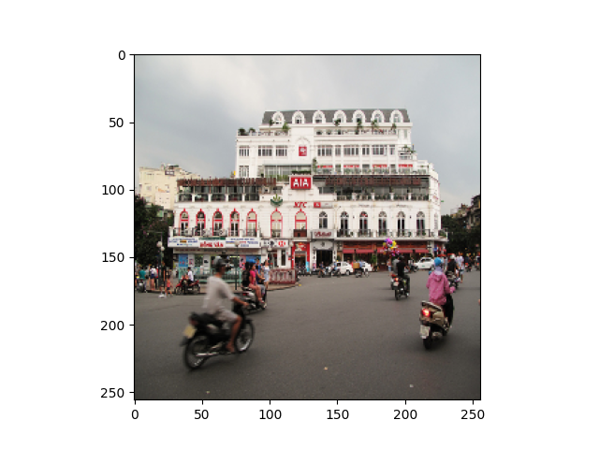
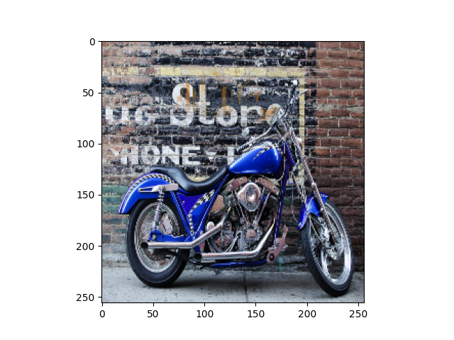
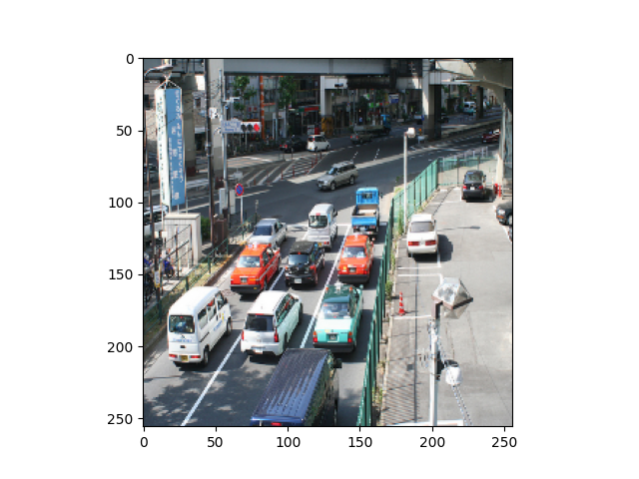
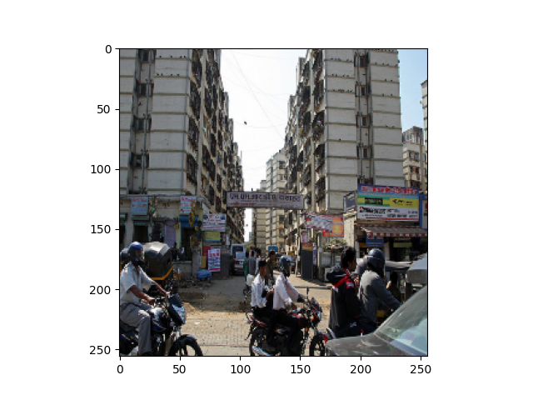
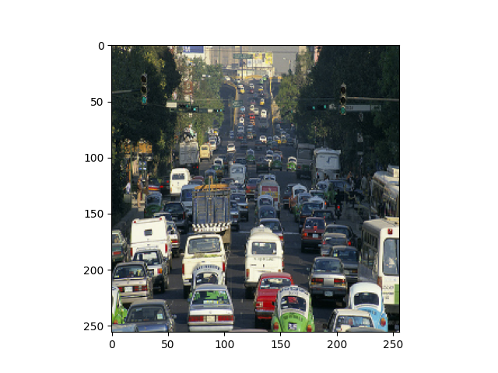
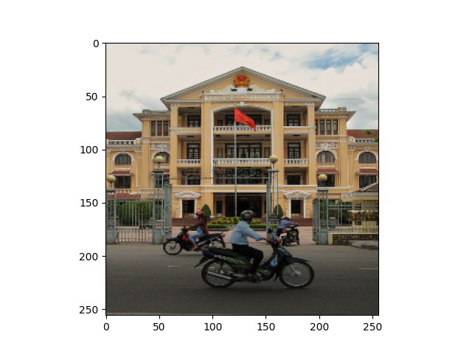

GT image:
Text-to-Image: Comparison FastText and BERT
Query Caption: Rows of motor bikes and helmets in a city.
Best 5 retrieved images in order from most similar to less (from left to right):
FastText
BERT
Notes:
With FastText we retrieve as first image one that is very similar to the GT. Moreover, the correct GT image is retrieved as third image. With BERT the system has some problems as it retrieves also cars, or traffic environments, not only motor bikes.

Slide 24
Conclusions

Slide 25
Conclusions
Advantages of PyTorch over Keras → computational efficiency and flexibility, which make it better suited for handling computationally-intensive projects.
We delved into various visual recognition tasks, including object detection, instance segmentation, and metric learning for image retrieval → gain insight into the inner workings of Convolutional Neural Networks (CNNs), and their potential combined with different tasks like detection, segmentation and how it works relatively good still with out-of-context images. However, in some cases feature inference can still be a challenge.
We discovered the usage of deep learning techniques in applications like image retrieval, particularly for cross-modal retrieval scenarios. Additionally, we found that mining techniques can enhance the generalization capabilities of these models. However, we must exercise caution when employing these methods, as they can also introduce complexities in the training process, depending on the nature of the study.
Notes:
Throughout our exploration of PyTorch, we have discovered its advantages over Keras, particularly in terms of computational efficiency and flexibility, which make it better suited for handling computationally-intensive projects.
Throughout the duration of this project, we delved into various visual recognition tasks, including object detection, instance segmentation, and metric learning for image retrieval. Our work allowed us to gain insight into the inner workings of Convolutional Neural Networks (CNNs), and their potential combined with different tasks like detection, segmentation and how it works relatively good still with out-of-context images. However, we also saw how feature interference may be a challenge.
Our investigation into deep metric learning techniques revealed their utility in applications like image retrieval, particularly for cross-modal retrieval scenarios. Additionally, we found that mining techniques can enhance the generalization capabilities of these models. However, we must exercise caution when employing these methods, as they can also introduce complexities in the training process, depending on the nature of the study.

Slide 26
REFERENCES
Detectron2: "Detectron2: FAIR's Next-Generation Object Detection Library" by Yang et al. (2020). Available at: https://arxiv.org/abs/1911.07241
KITTY MOTS dataset: "KITTI MOTS: A Benchmark for Multi-Object Tracking and Segmentation" by Voigtlaender et al. (2019). Available at: https://arxiv.org/abs/1903.09231
Faster R-CNN: "Faster R-CNN: Towards Real-Time Object Detection with Region Proposal Networks" by Ren et al. (2016). Available at: https://arxiv.org/abs/1506.01497
Mask R-CNN: "Mask R-CNN" by He et al. (2017). Available at: https://arxiv.org/abs/1703.06870
M. J. Choi, A. Torralba, and A. S. Willsky, “Context models and out-of-context objects,” Pattern Recogn. Lett., vol. 33,p. 853–862, may 2012
MS-COCO: "Microsoft COCO: Common Objects in Context" by Lin et al. (2014). Available at: https://arxiv.org/abs/1405.0312
ResNet50: "Deep Residual Learning for Image Recognition" by He et al. (2016). Available at: https://arxiv.org/abs/1512.03385
FastText: "Enriching Word Vectors with Subword Information" by Bojanowski et al. (2017). Available at: https://arxiv.org/abs/1607.04606
BERT: "BERT: Pre-training of Deep Bidirectional Transformers for Language Understanding" by Devlin et al. (2018). Available at: https://arxiv.org/abs/1810.04805
ImageNet dataset: "ImageNet: A Large-Scale Hierarchical Image Database" by Deng et al. (2009). Available at: https://ieeexplore.ieee.org/document/5206848
Notes:
Task a:
Object detection models such as FasterRCNN and MaskRCNN can struggle with object recognition when textures are similar or when objects are outside their context. FasterRCNN can misclassify objects with similar textures, while MaskRCNN can more accurately detect such objects. However, both models can still correctly detect and label objects outside their context in most cases.
Task b:
When transplanting objects into new images using MaskRCNN, the model is generally able to recognize the transplanted objects, especially for cases such as dogs and clocks. However, in some cases, such as TVs in dark backgrounds, the model may fail to detect the objects. This highlights the importance of background and lighting conditions for object detection.
Task c:
The background of an image plays a critical role in object detection accuracy, and overlapping or partially occluded objects can be challenging for the model. Duplicating objects in an image can provide additional information that can help the model detect and classify objects more accurately, especially if the duplicated object is in a different location or under different lighting conditions than the original object.
Task d:
Feature interference can be harmful to the detection process in MaskRCNN, as features obtained from pixels outside the region of interest can interfere with the predictions. Adding random noise can further amplify this issue. Therefore, it is essential to pay attention to the pixels and features included in the model's training and detection processes.
Task e:
Style transfer can impact object detectability, as some styles may result in texture loss and non-uniform contours, making it more difficult for object detection models to identify objects. It is important to choose styles that preserve object details and contours to minimize the impact on object detection accuracy.

